Slide 1
WeFeet
Tom Baeten – Kevin van Driel
Atte Paananen – Robin Huumonen
Quinten Schutyser – Lennert Van Riel

Slide 2
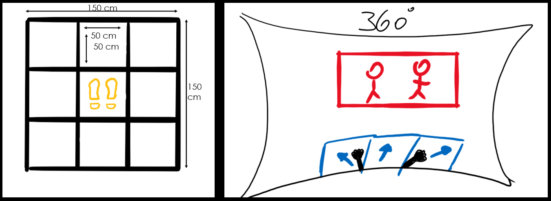
CONCEPT
Notes:
Kevin

Slide 3
Architecture
MAT
ARDUINO
SERIAL
UNITY
HEADSET
CONTROLLERS
Notes:
Tom

Slide 4
Architecture
MAT
ARDUINO
On every change
SERIAL
UNITY
HEADSET
Status whole mat:
000010000,
CONTROLLERS
Notes:
Tom

Slide 5
Architecture
MENU
UNITY
CHOOSE SCENE
CHOOSE SONG
LOADING
OPTIONS
PLAY MOVIE
MOVEMENT
Notes:
Tom

Slide 6
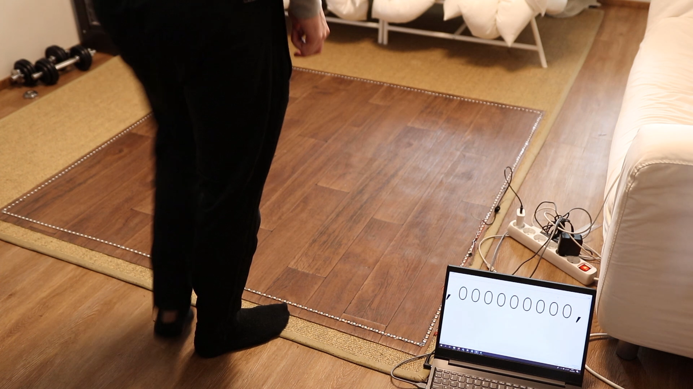
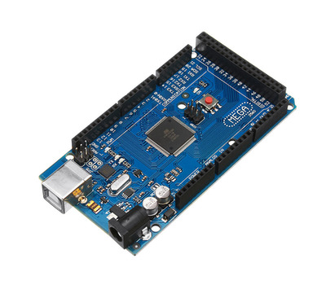
Technologies
Notes:
Atte-Robin

Slide 7
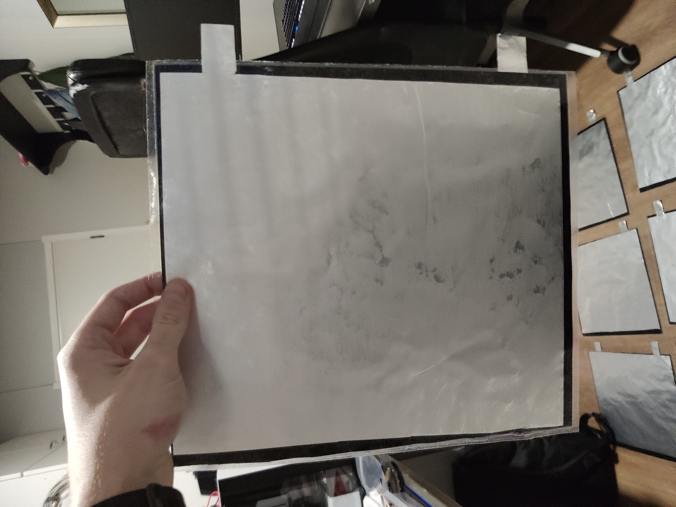
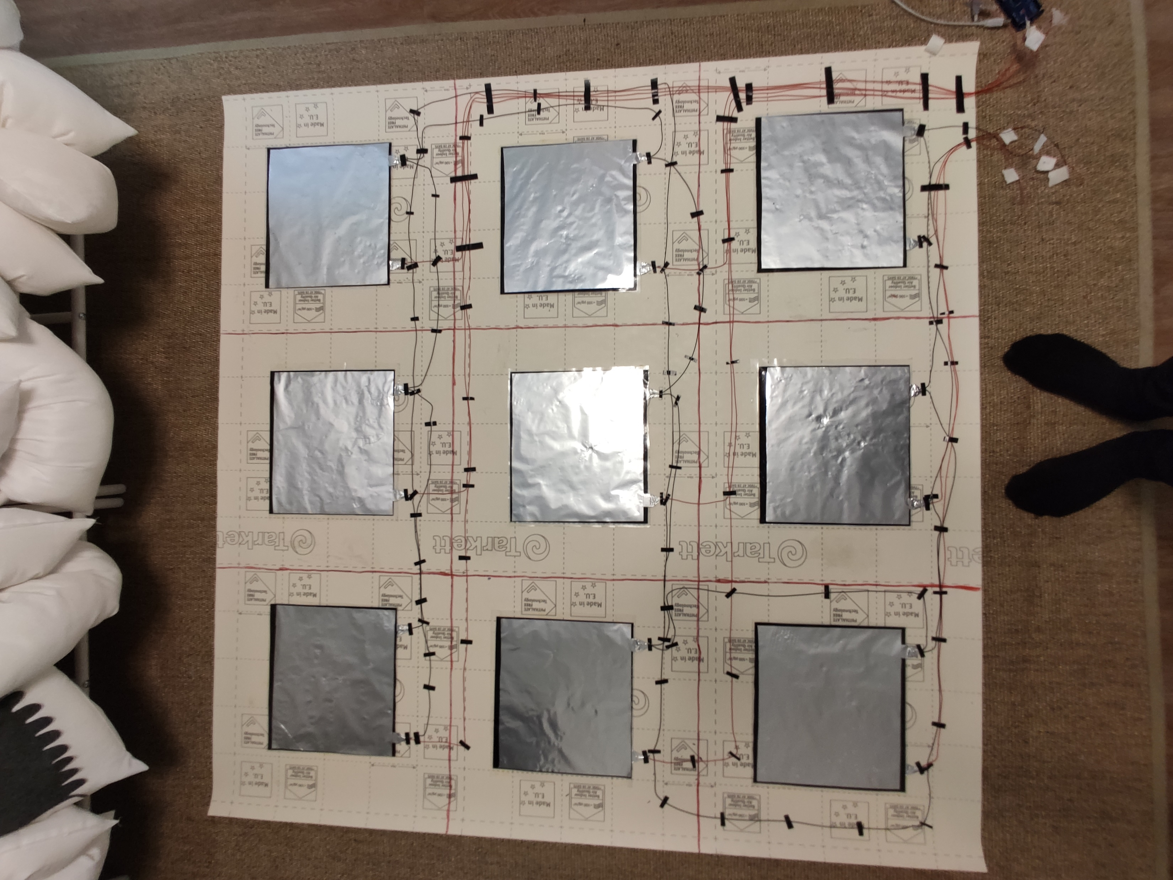
Technologies
Notes:
Atte-Robin

Slide 8
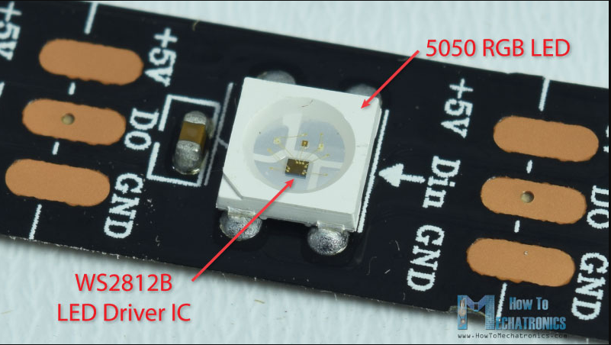
Technologies
FASTLED library
Notes:
Atte-Robin

Slide 9
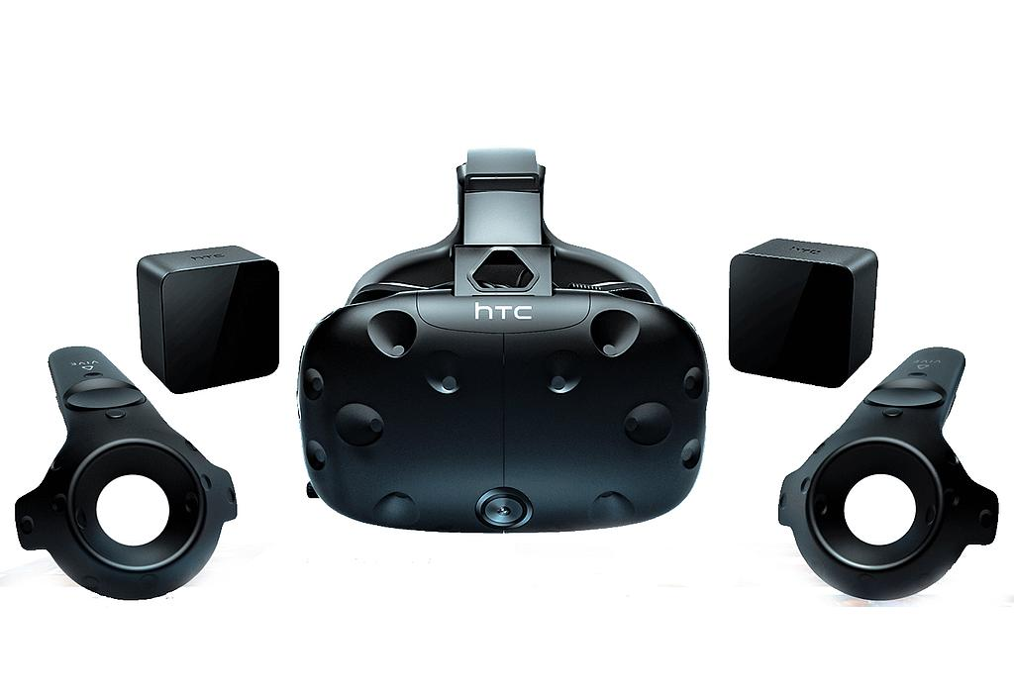

Technologies
Notes:
Lennert

Slide 10
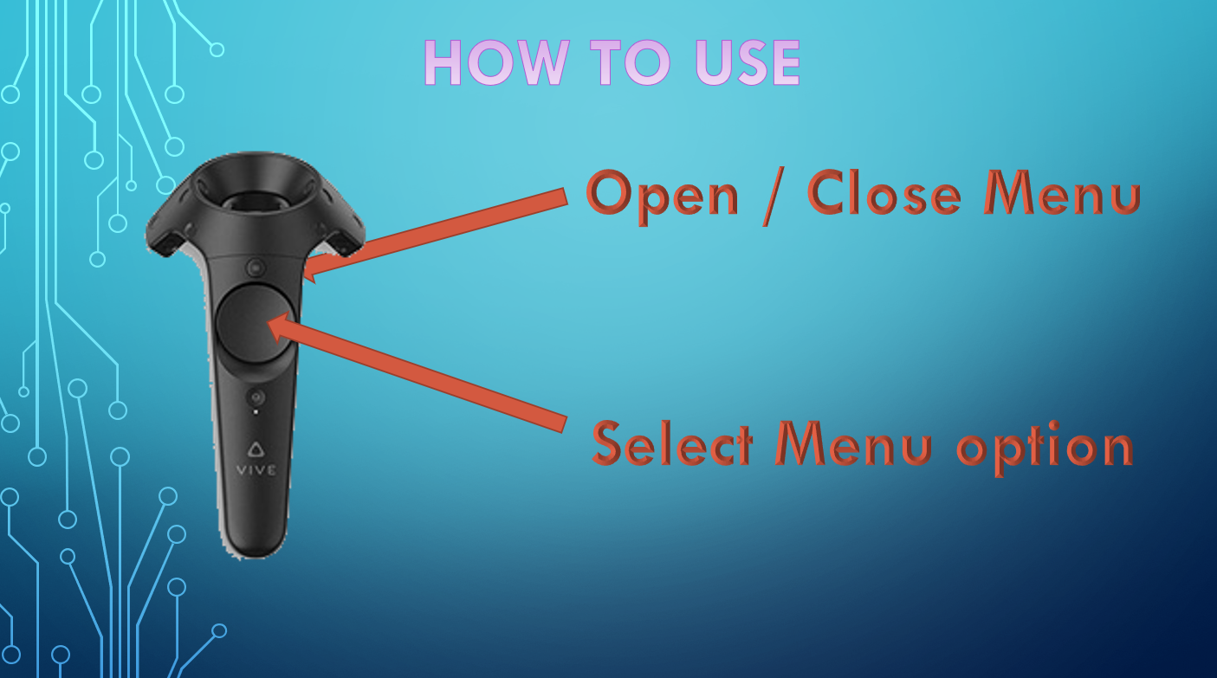
Features
Notes:
Lennert

Slide 11
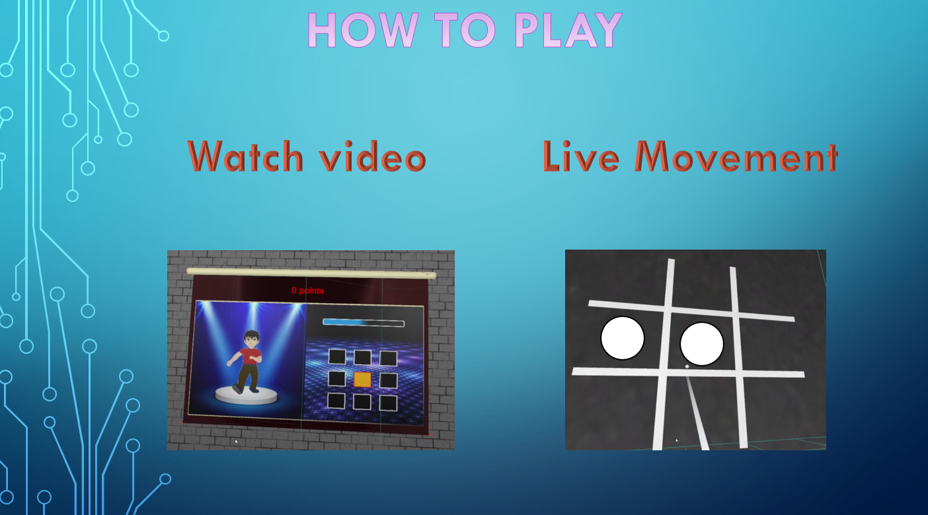
Features
Notes:
Lennert

Slide 12
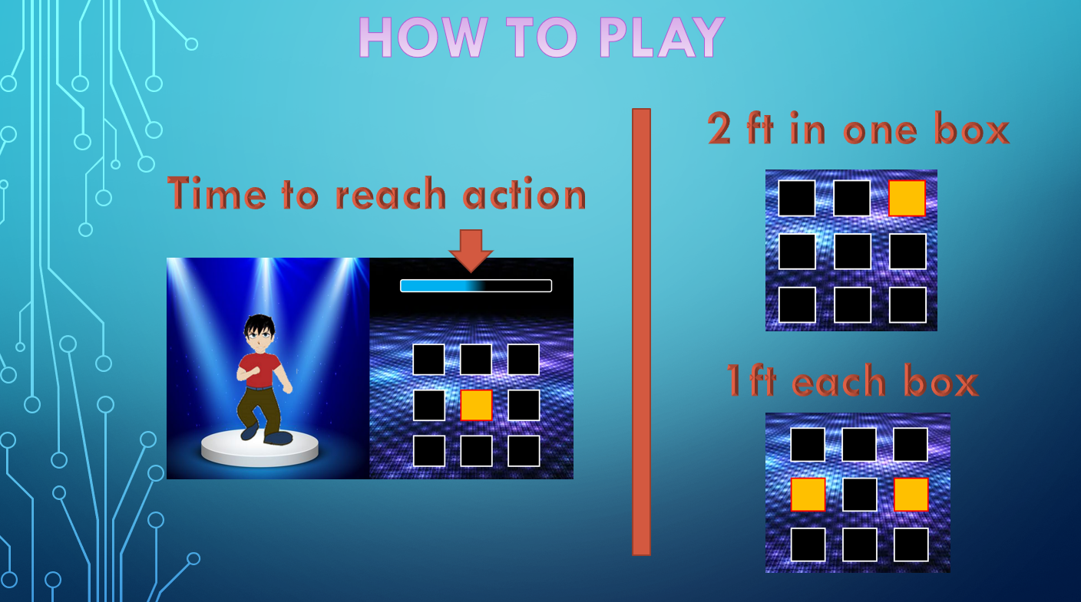
Features
Notes:
Lennert

Slide 13

Features
Notes:
Tom

Slide 14
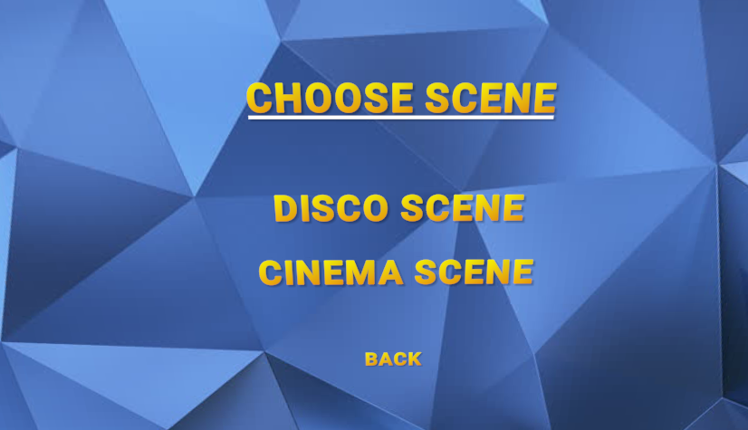
Features
Notes:
Tom

Slide 15
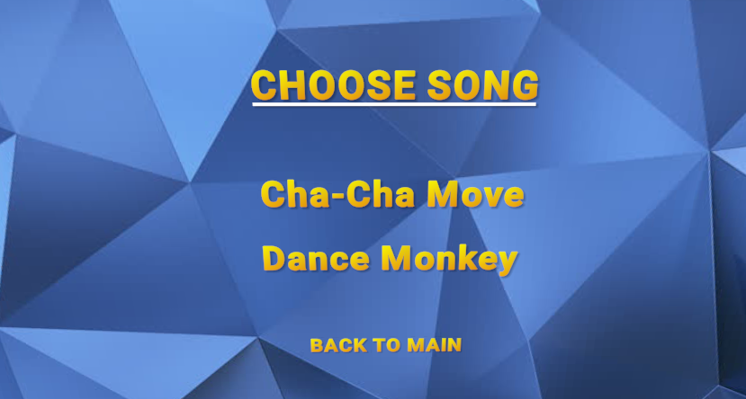
Features
Notes:
Tom

Slide 16
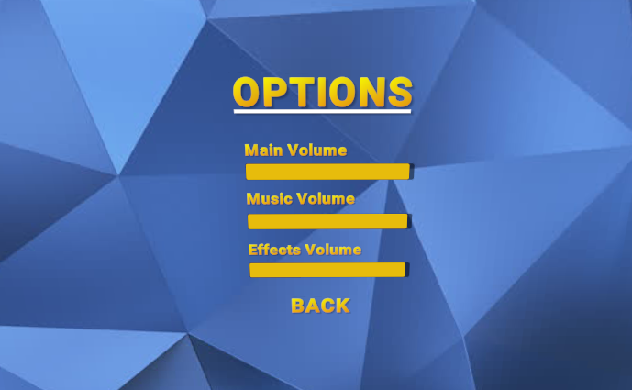
Features
Notes:
Quinten

Slide 17
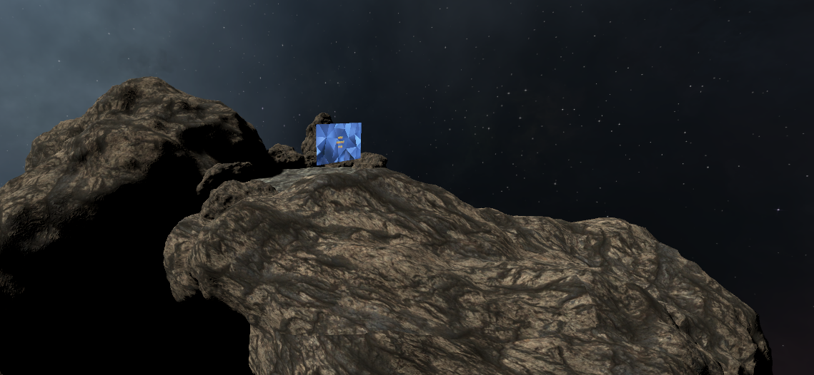
Features
Notes:
Quinten

Slide 18
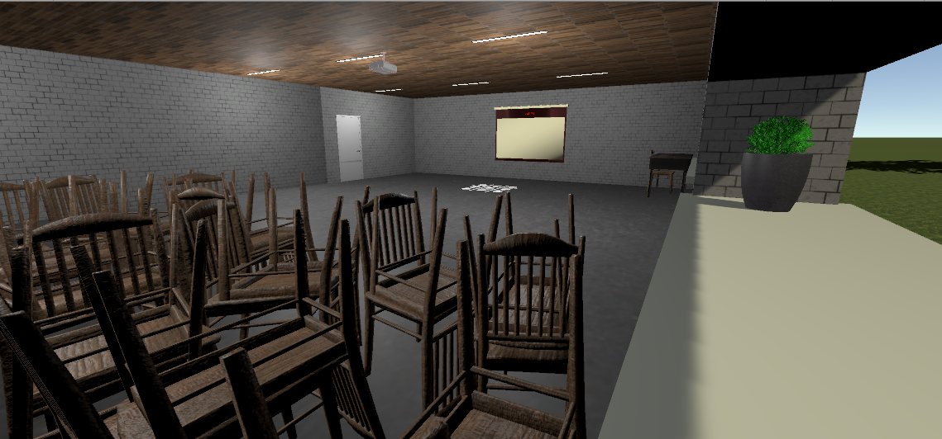
Features
Notes:
Lennert

Slide 19
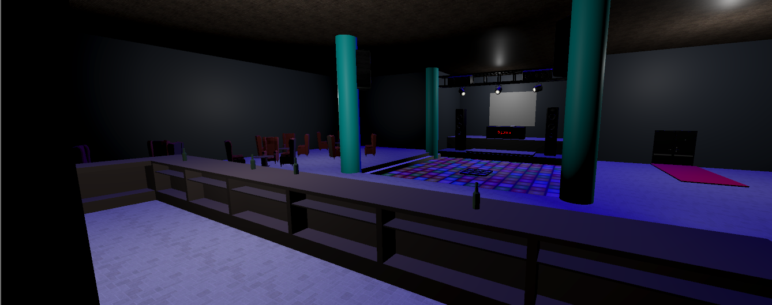
Features
Notes:
Kevin

Slide 20
Live Demo
By Kevin van Driel
Notes:
Kevin

Slide 21
Individual contributions

Slide 22
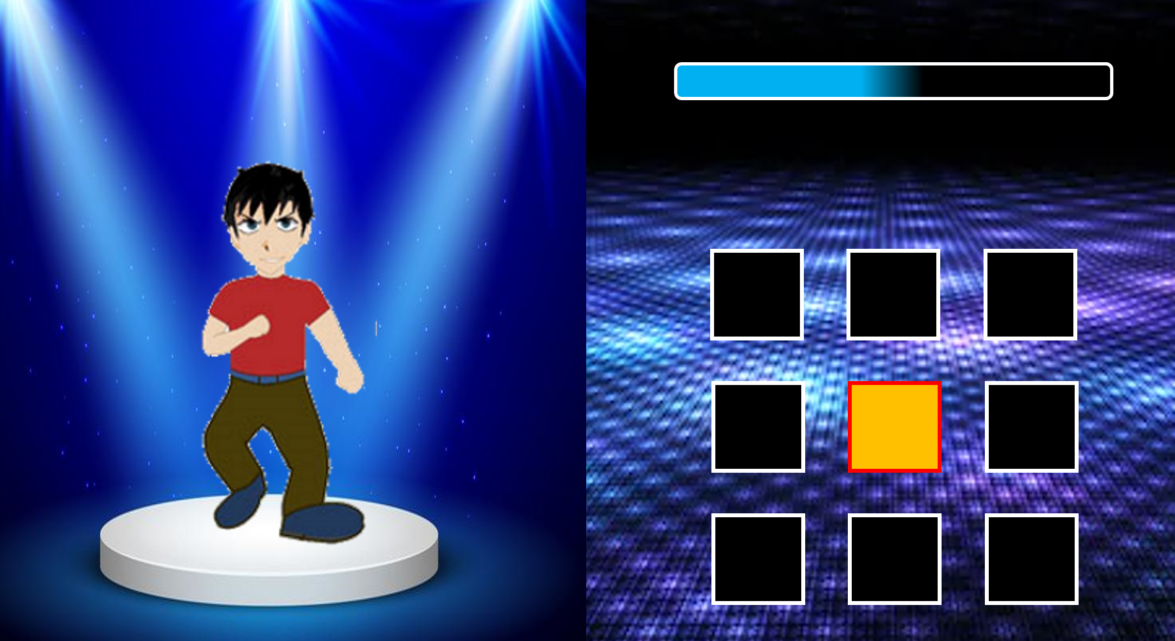
Tom Baeten
Menu
Created dance movies
made with powerpoint ☺
Incl Timings
Helping button controls
Simulate mat code for arduino
Notes:
Tom

Slide 23
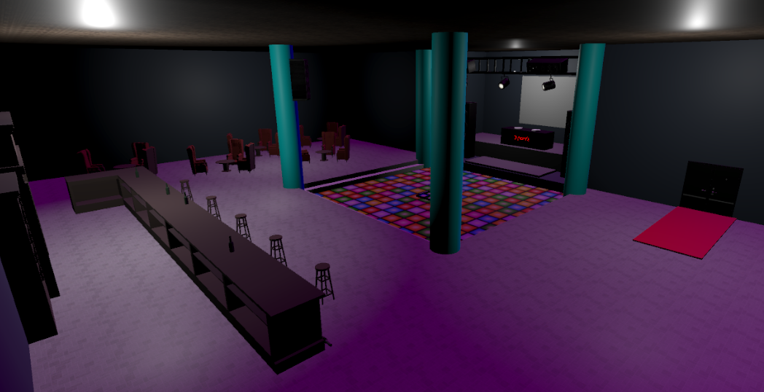
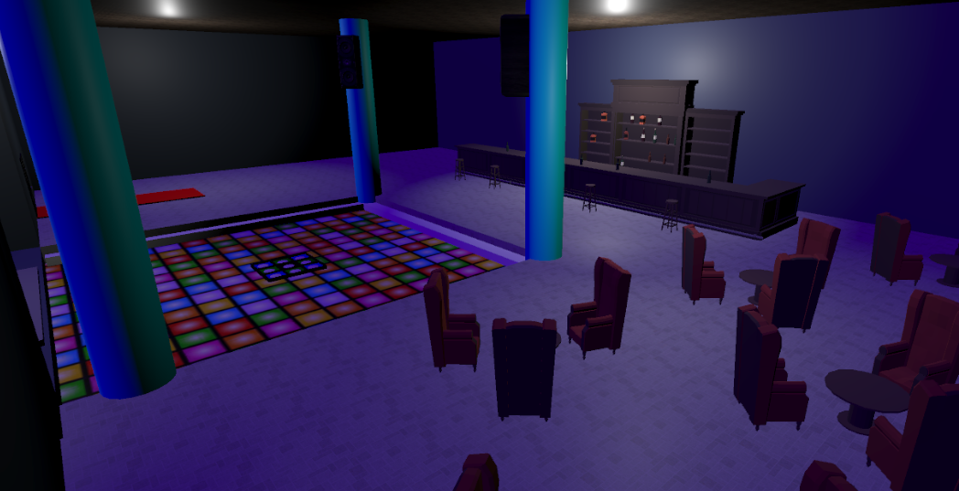
Kevin van Driel
Disco scene
Player via steam vr
Testing code, giving feedback
Testing mat via dummy arduino buttons
Testing and connecting the real mat
Record demo's
Notes:
Kevin

Slide 24
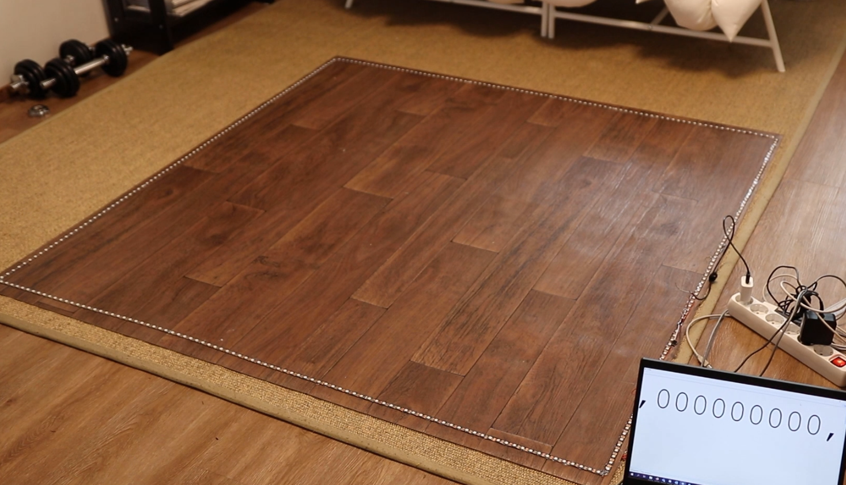
Atte Paananen
Testing different ways to build the mat
Assembling the mat
Finalizing the Arduino code to work with the mat
Notes:
Atte

Slide 25
Robin Huumonen
Technology tests and selection
Arduino code for the mat and LEDs
Notes:
Robin

Slide 26

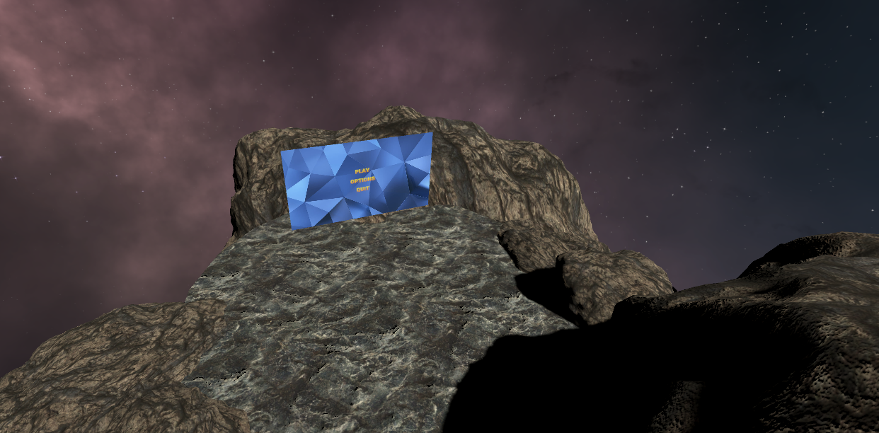
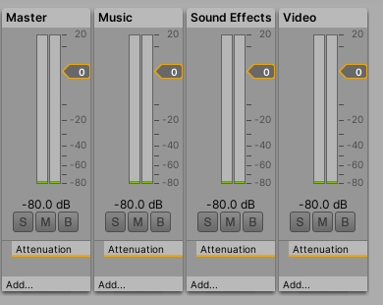
Quinten Schutyser
Menu scene
Sound (Audio Manager)
Button control
Helping with Menu
Option Menu
Notes:
Quinten

Slide 27
Lennert Van Riel
Cinema/classroom scene
Serial communication in Unity
Move detection and visualization
Scripts for the dances
Scoring script
Notes:
Lennert

Slide 28

Teamwork
What went well
Communication
Setting up
Learning Unity
Creating mat
Notes:
Lennert

Slide 29

Teamwork
What went wrong?
Corona ☹
Keeping the Jira up to date
Not getting distracted with extra features
What would we change?
More clear userstories
More communication between sprints
Better unity structure in imports
Notes:
Quinten

Slide 30
Concolusion & reflection
All goals achieved
Basic goals and some extra features
Scoreboard not achieved
Problems
Some minor merge problems
Notes:
Quinten

Slide 31
Concolusion & reflection
Team spirit
A lot of productivity
A decent amount of fun
A couple of less productive moments
Notes:
Quinten

Slide 32
ANY QUESTIONS ?
Notes:
Tom

